Slide 1
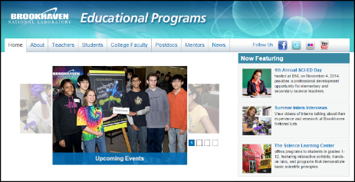
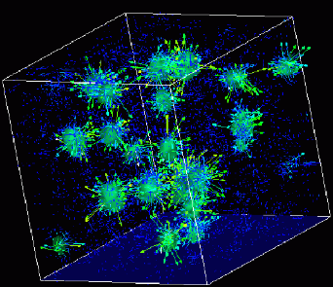

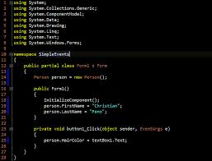
Advanced
Scientific Computing
(SciComp 201)
Session 31
Minimizing Search Spaces

Slide 2
Session Goals
Manage combinatorial (exponential) explosion in search space using pre-ordering and divide & conquer patterns
Generate and discover simple and compound anagrams

Slide 3
Anagrams
Different words all spelled with the same set of letters are called anagrams
Given an English dictionary, how would you find all the anagrams of a word?
What algorithm would you use? Trial and error?
Word | Letters | Anagrams | Permutations
STOP | 4 | 6 | 24
LEAST | 5 | 10 | 120
TRACES | 6 | 9 | 720
PLAYERS | 7 | 7 | 5,040
RESTRAIN | 8 | 6 | 40,320
MASTERING | 9 | 4 | 362,880
SUPERSONIC | 10 | 3 | 3,628,800

Slide 4
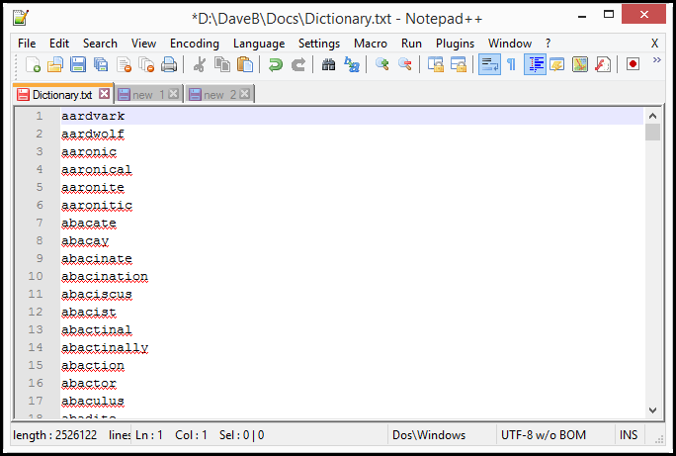
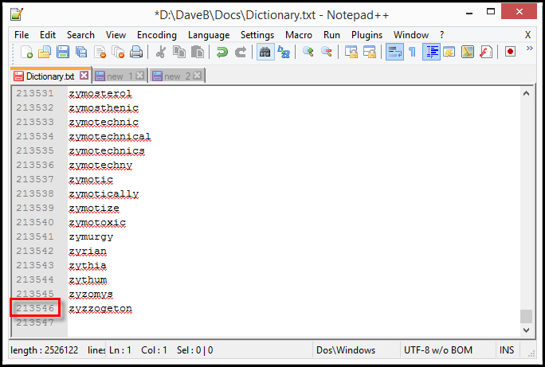
Anagrams

Slide 5
Anagrams
stop = post, pots, spot, tops
least = slate, stale, steal, tales
traces = carets, caster, caters, crates, reacts, recast
players = parsley, parleys, replays, sparely
restrain = retrains, strainer, terrains, trainers
mastering = emigrants, streaming
supersonic = percussion
Naive Approach = Try every possible permutation of all given letters, checking in dictionary file to see if that permutation it is a valid word

Slide 6
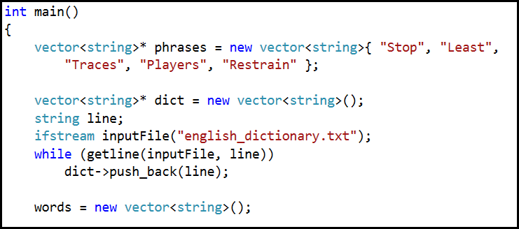
Lab 1 – Slow Anagrams

Slide 7
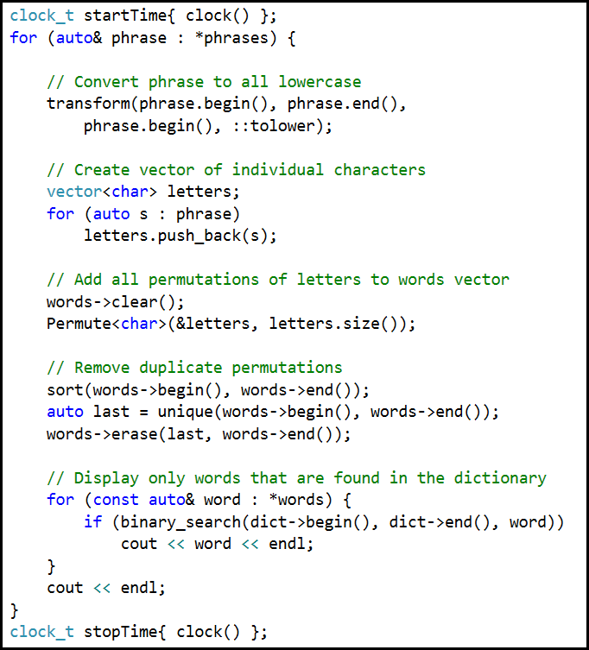
Lab 1 Slow Anagrams

Slide 8
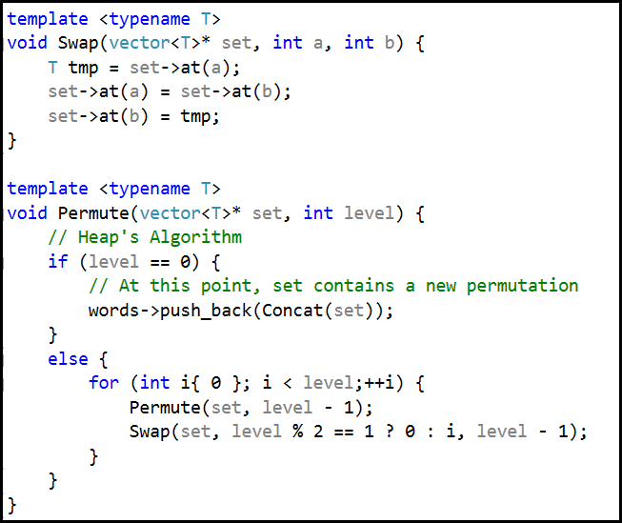
Lab 1 – Slow Anagrams

Slide 9
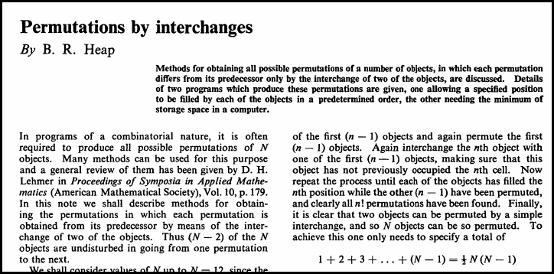
Lab 1 – Slow Anagrams
1963

Slide 10
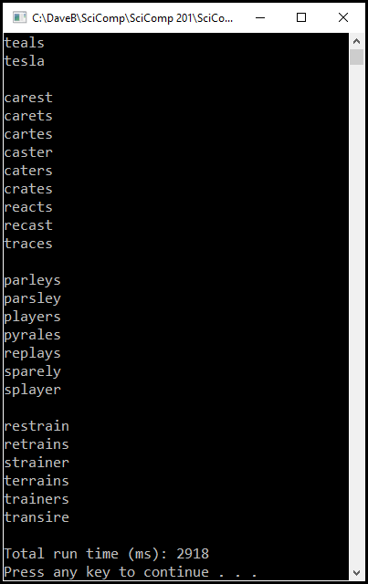
Lab 1 – Slow Anagrams
Stop
Least
Traces
Players
Restrain

Slide 11
Anagrams
stop = post, pots, spot, tops
least = slate, stale, steal, tales
traces = carets, caster, caters, crates, reacts, recast
players = parsley, parleys, replays, sparely
restrain = retrains, strainer, terrains, trainers
mastering = emigrants, streaming
supersonic = percussion
Novel Approach - Thinking in reverse! First, SORT the given dictionary file by word letter order, then SEARCH for equal first columns (e.g. “OPST”) to find all anagrams in the dictionary

Slide 12
A way of finding anagrams that much
faster than by trying every permutation!
POSSUM |  | M | O | P | S | S | U |  |  | MOPSSU
POST |  | O | P | S | T |  |  |  |  | OPST
POSTAGE |  | A | E | G | O | P | S | T |  | AEGOPST
POTION |  | I | N | O | O | P | T |  |  | INOOPT
POTS |  | O | P | S | T |  |  |  |  | OPST
POUCH |  | C | H | O | P | U |  |  |  | CHOPU
SPOT |  | O | P | S | T |  |  |  |  | OPST
SPOUSE |  | E | O | P | S | S | U |  |  | EOPSSU
STOP |  | O | P | S | T |  |  |  |  | OPST
TOPICS |  | C | I | O | P | S | T |  |  | CIOPST
TOPS |  | O | P | S | T |  |  |  |  | OPST
TORCH |  | C | H | O | R | T |  |  |  | CHORT

Slide 13
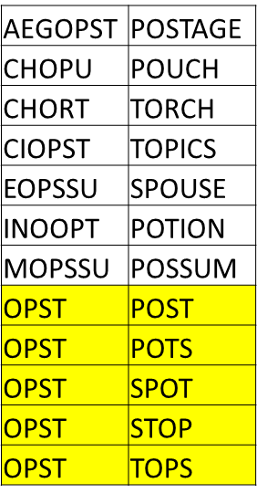
MOPSSU | POSSUM
OPST | POST
AEGOPST | POSTAGE
INOOPT | POTION
OPST | POTS
CHOPU | POUCH
OPST | SPOT
EOPSSU | SPOUSE
OPST | STOP
CIOPST | TOPICS
OPST | TOPS
CHORT | TORCH

Slide 14
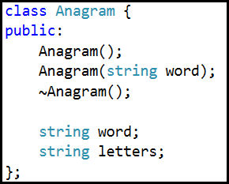
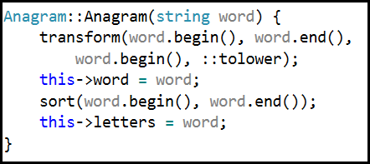
Lab 2 – Fast Anagrams

Slide 15
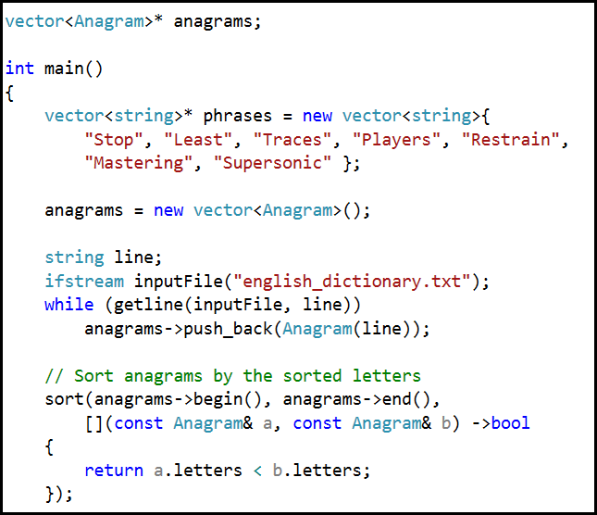
Lab 2 – Fast Anagrams

Slide 16
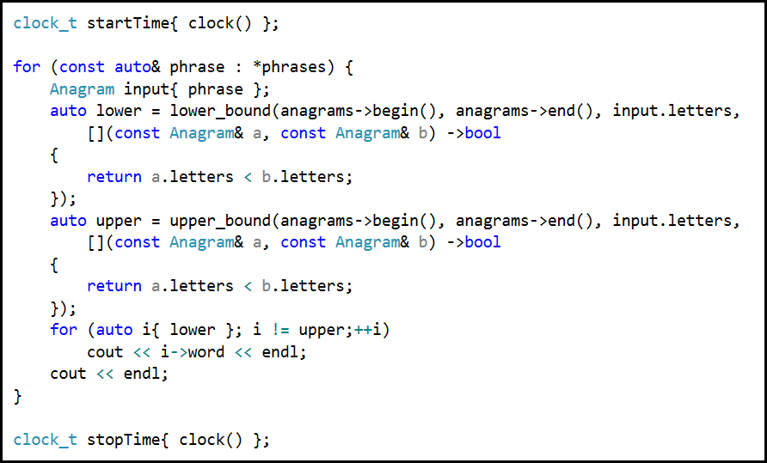
Lab 2 – Fast Anagrams

Slide 17
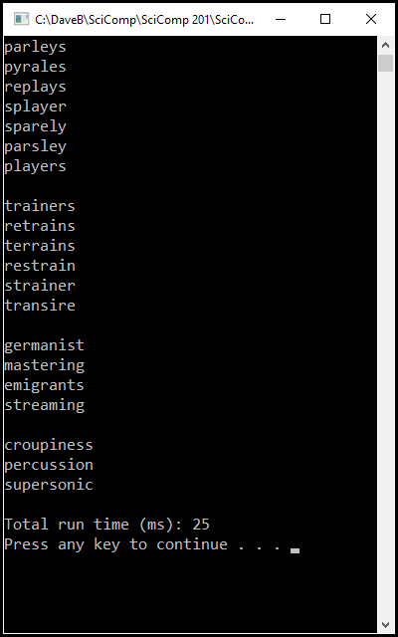
Lab 2 – Fast Anagrams
Stop
Least
Traces
Players
Restrain
Mastering
Supersonic

Slide 18
Slow vs. Fast Anagrams
Slow Anagram approach took 2918 ms, Fast Anagram approach took 25ms, ~10X faster with 3 bigger words!
Even binary searching cannot overcome the penalty of enumerating over permutations which could never be valid English words
The dictionary is your search space – don’t artificially expand the search space with unconstrained permutations – this leads to combinational explosion
Supersonic has 3M letter permutations, but only 3 anagrams
Elvis = Lives . . . Listen = Silent

Slide 19
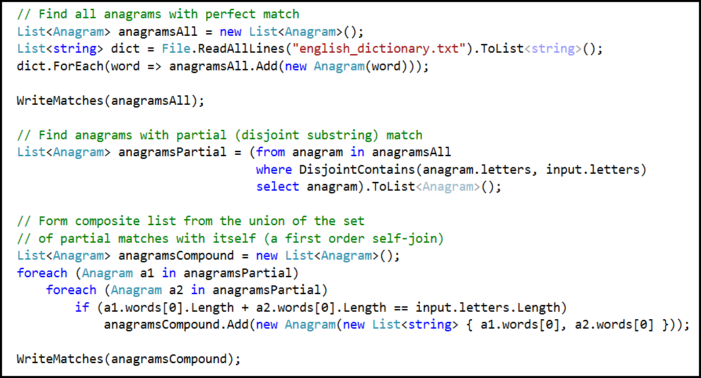

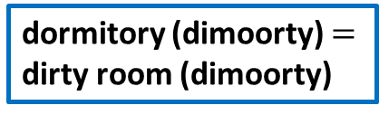
Lab 3 - Compound Anagrams
dormitory (dimoorty) $≈$ room (moor)
dormitory (dimoorty) $=$ dirty room (dimoorty)

Slide 20
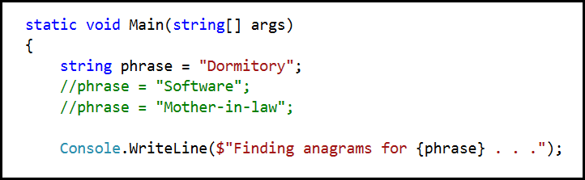
Lab 3 - Compound Anagrams
Uncomment the other phrases to reveal their lurking compound anagrams ☺

Slide 21
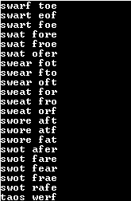
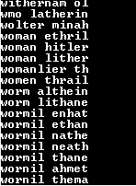
Lab 3 - Compound Anagrams
Uncomment the other phrases to reveal their lurking compound anagrams ☺
Software
Mother-In-Law

Slide 22
Who knew?
The Morse Code = Here come dots
The meaning of life = The fine game of nil
Statue of Liberty = Built to stay free

